Slide 1
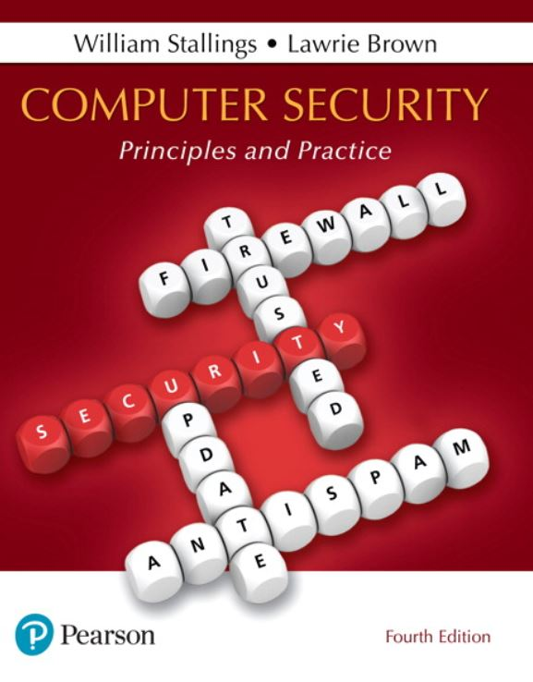
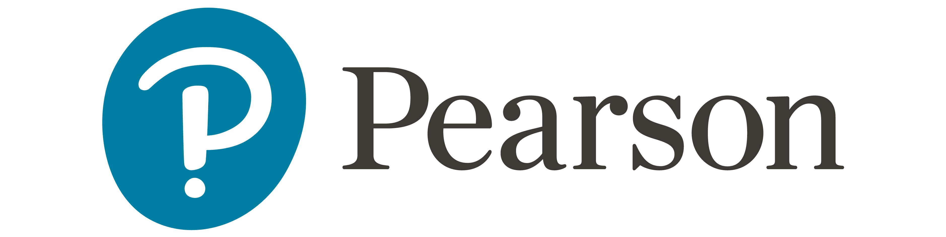
Computer Security: Principles and Practice
Fourth Edition
Chapter 14
Risk Assessment
Copyright © 2018, 2015, 2012 Pearson Education, Inc. All Rights Reserved
Notes:
If this PowerPoint presentation contains mathematical equations, you may need to check that your computer has the following installed:
1) MathType Plugin
2) Math Player (free versions available)
3) NVDA Reader (free versions available)
In previous chapters, we discussed a range of technical and administrative measures that can be used to manage and improve the security of computer systems and networks. In this chapter and the next, we look at the process of how to best select and implement these measures to effectively address an organization’s security requirements. As we noted in Chapter 1, this involves examining three fundamental questions:
1. What assets do we need to protect?
2. How are those assets threatened?
3. What can we do to counter those threats?

Slide 2
Security Risk Assessment
Critical component of process
Ideally examine every organizational asset
Not feasible in practice
Approaches to identifying and mitigating risks to an organization’s I T infrastructure:
Baseline
Informal
Detailed risk
Combined
Notes:
We now turn to the key risk management component of the IT security process. This stage is critical, because without it there is a significant chance that resources will not be deployed where most effective. The result will be that some risks are not addressed, leaving the organization vulnerable, while other safeguards may be deployed without sufficient justification, wasting time and money. Ideally every single organizational asset is examined, and every conceivable risk to it is evaluated. If a risk is judged to be too great, then appropriate remedial controls are deployed to reduce the risk to an acceptable level. In practice this is clearly impossible. The time and effort required, even for large, well-resourced organizations, is clearly neither achievable nor cost effective. Even if possible, the rapid rate of change in both IT technologies and the wider threat environment means that any such assessment would be obsolete as soon as it is completed, if not earlier! Clearly some form of compromise evaluation is needed.
Another issue is the decision as to what constitutes an appropriate level of risk to accept. In an ideal world the goal would be to eliminate all risks completely. Again, this is simply not possible. A more realistic alternative is to expend an amount of resources in reducing risks proportional to the potential costs to the organization should that risk occur. This process also must take into consideration the likelihood of the risk’s occurrence. Specifying the acceptable level of risk is simply prudent management and means that resources expended are reasonable in the context of the organization’s available budget, time, and personnel resources. The aim of the risk assessment process is to provide management with the information necessary for them to make reasonable decisions on where available resources will be deployed.
Given the wide range of organizations, from very small businesses to global multinationals and national governments, there clearly needs to be a range of alternatives available in performing this process. There are a range of formal standards that detail suitable IT security risk assessment processes, including ISO 13335, ISO 27005, ISO 31000, and NIST SP 800-30. In particular, ISO 13335 recognizes four approaches to identifying and mitigating risks to an organization’s IT infrastructure:
• Baseline approach
• Informal approach
• Detailed risk analysis
• Combined approach
The choice among these will be determined by the resources available to the organization and from an initial high-level risk analysis that considers how valuable the IT systems are and how critical to the organization’s business objectives. Legal and regulatory constraints may also require specific approaches. This information should be determined when developing the organization’s IT security objectives, strategies, and policies.

Slide 3
Baseline Approach
Goal is to implement agreed controls to provide protection against the most common threats
Forms a good base for further security measures
Use “industry best practice”
Easy, cheap, can be replicated
Gives no special consideration to variations in risk exposure
May give too much or too little security
Generally recommended only for small organizations without the resources to implement more structured approaches
Notes:
The baseline approach to risk assessment aims to implement a basic general level of security controls on systems using baseline documents, codes of practice, and industry best practice. The advantages of this approach are that it doesn’t require the expenditure of additional resources in conducting a more formal risk assessment and that the same measures can be replicated over a range of systems. The major disadvantage is that no special consideration is given to variations in the organization’s risk exposure based on who they are and how their systems are used. Also, there is a chance that the baseline level may be set either too high, leading to expensive or restrictive security measures that may not be warranted, or set too low, resulting in insufficient security and leaving the organization vulnerable.
The goal of the baseline approach is to implement generally agreed controls to provide protection against the most common threats. These would include implementing industry best practice in configuring and deploying systems, like those we discuss in Chapter 12 on operating systems security. As such, the baseline approach forms a good base from which further security measures can be determined.
Suitable baseline recommendations and checklists may be obtained from a range of organizations, including:
• Various national and international standards organizations
• Security-related organizations such as the CERT, NSA, and so on
• Industry sector councils or peak groups
The use of the baseline approach alone would generally be recommended only for small organizations without the resources to implement more structured approaches. But it will at least ensure that a basic level of security is deployed, which is not guaranteed by the default configurations of many systems.

Slide 4
Informal Approach
Involves conducting an informal, pragmatic risk analysis on organization’s I T systems
Exploits knowledge and expertise of analyst
Fairly quick and cheap
Judgments can be made about vulnerabilities and risks that baseline approach would not address
Some risks may be incorrectly assessed
Skewed by analyst’s views, varies over time
Suitable for small to medium sized organizations where I T systems are not necessarily essential
Notes:
The informal approach involves conducting some form of informal, pragmatic risk analysis for the organization’s IT systems. This analysis does not involve the use of a formal, structured process, but rather exploits the knowledge and expertise of the individuals performing this analysis. These may either be internal experts, if available, or, alternatively, external consultants. A major advantage of this approach is that the individuals performing the analysis require no additional skills. Hence, an informal risk assessment can be performed relatively quickly and cheaply. In addition, because the organization’s systems are being examined, judgments can be made about specific vulnerabilities and risks to systems for the organization that the baseline approach would not address. Thus more accurate and targeted controls may be used than would be the case with the baseline approach. There are a number of disadvantages. Because a formal process is not used, there is a chance that some risks may not be considered appropriately, potentially leaving the organization vulnerable. Besides, because the approach is informal, the results may be skewed by the views and prejudices of the individuals performing the analysis. It may also result in insufficient justification for suggested controls, leading to questions over whether the proposed expenditure is really justified. Lastly, there may be inconsistent results over time as a result of differing expertise in those conducting the analysis.
The use of the informal approach would generally be recommended for small to medium-sized organizations where the IT systems are not necessarily essential to meeting the organization’s business objectives and where additional expenditure on risk analysis cannot be justified.

Slide 5
Detailed Risk Analysis
Most comprehensive approach
Assess using formal structured process
Number of stages
Identify threats and vulnerabilities to assets
Identify likelihood of risk occurring and consequences
Significant cost in time, resources, expertise
May be a legal requirement to use
Suitable for large organizations with I T systems critical to their business objectives
Notes:
The third and most comprehensive approach is to conduct a detailed risk assessment of the organization’s IT systems, using a formal structured process. This provides the greatest degree of assurance that all significant risks are identified and their implications considered. This process involves a number of stages, including identification of assets, identification of threats and vulnerabilities to those assets, determination of the likelihood of the risk occurring and the consequences to the organization should that occur, and hence the risk the organization is exposed to. With that information, appropriate controls can be chosen and implemented to address the risks identified. The advantages of this approach are that it provides the most detailed examination of the security risks of an organization’s IT system, and produces strong justification for expenditure on the controls proposed. It also provides the best information for continuing to manage the security of these systems as they evolve and change. The major disadvantage is the significant cost in time, resources, and expertise needed to perform such an analysis. The time taken to perform this analysis may also result in delays in providing suitable levels of protection for some systems. The details of this approach are discussed in the next section.
The use of a formal, detailed risk analysis is often a legal requirement for some government organizations and businesses providing key services to them. This may also be the case for organizations providing key national infrastructure. For such organizations, there is no choice but to use this approach. It may also be the approach of choice for large organizations with IT systems critical to their business objectives and with the resources available to perform this type of analysis.

Slide 6
Combined Approach
Combines elements of the baseline, informal, and detailed risk analysis approaches
Aim is to provide reasonable levels of protection as quickly as possible then to examine and adjust the protection controls deployed on key systems over time
Approach starts with the implementation of suitable baseline security recommendations on all systems
Next, systems either exposed to high risk levels or critical to the organization's business objectives are identified in the high-level risk assessment
A decision can then be made to possibly conduct an immediate informal risk assessment on key systems, with the aim of relatively quickly tailoring controls to more accurately reflect their requirements
Lastly, an ordered process of performing detailed risk analyses of these systems can be instituted
Over time, this can result in the most appropriate and cost-effective security controls being selected and implemented on these systems
Notes:
The last approach combines elements of the baseline, informal, and detailed risk analysis approaches. The aim is to provide reasonable levels of protection as quickly as possible, and then to examine and adjust the protection controls deployed on key systems over time. The approach starts with the implementation of suitable baseline security recommendations on all systems. Next, systems either exposed to high risk levels or critical to the organization’s business objectives are identified in the high-level risk assessment. A decision can then be made to possibly conduct an immediate informal risk assessment on key systems, with the aim of relatively quickly tailoring controls to more accurately reflect their requirements. Lastly, an ordered process of performing detailed risk analyses of these systems can be instituted. Over time this can result in the most appropriate and cost-effective security controls being selected and implemented on these systems. This approach has a significant number of advantages. The use of the initial high-level analysis to determine where further resources need to be expended, rather than facing a full detailed risk analysis of all systems, may well be easier to sell to management. It also results in the development of a strategic picture of the IT resources and where major risks are likely to occur. This provides a key planning aid in the subsequent management of the organization’s security. The use of the baseline and informal analyses ensures that a basic level of security protection is implemented early. And it means that resources are likely to be applied where most needed and that systems most at risk are likely to be examined further reasonably early in the process. However, there are some disadvantages. If the initial high-level analysis is inaccurate, then some systems for which a detailed risk analysis should be performed may remain vulnerable for some time. Nonetheless, the use of the baseline approach should ensure a basic minimum security level on such systems. Further, if the results of the high-level analysis are reviewed appropriately, the chance of lingering vulnerability is minimized.
ISO13335 considers that for most organizations, in most circumstances, this approach is the most cost effective. Consequently its use is highly recommended.

Slide 7
Detailed Security Risk Analysis
Provides the most accurate evaluation of an organization's I T system’s security risks
Highest cost
Initially focused on addressing defense security concerns
Often mandated by government organizations and associated businesses
Notes:
The formal, detailed security risk analysis approach provides the most accurate evaluation of an organization’s IT system’s security risks, but at the highest cost. This approach has evolved with the development of trusted computer systems, initially focused on addressing defense security concerns, as we discuss in Chapter 13 . The original security risk assessment methodology was given in the Yellow Book standard (CSC-STD-004-85 June 1985), one of the original U.S. TCSEC rainbow book series of standards. Its focus was entirely on protecting the confidentiality of information, reflecting the military concern with information classification. The recommended rating it gave for a trusted computer system depended on difference between the minimum user clearance and the maximum information classification. Specifically it defined a risk index as
Risk Index = Max Info Sensitivity - Min User Clearance
A table in this standard, listing suitable categories of systems for each risk level, was used to select the system type. Clearly this limited approach neither adequately reflects the range of security services required nor the wide range of possible threats. Over the years since, the process of conducting a security risk assessment that does consider these issues has evolved.

Slide 8
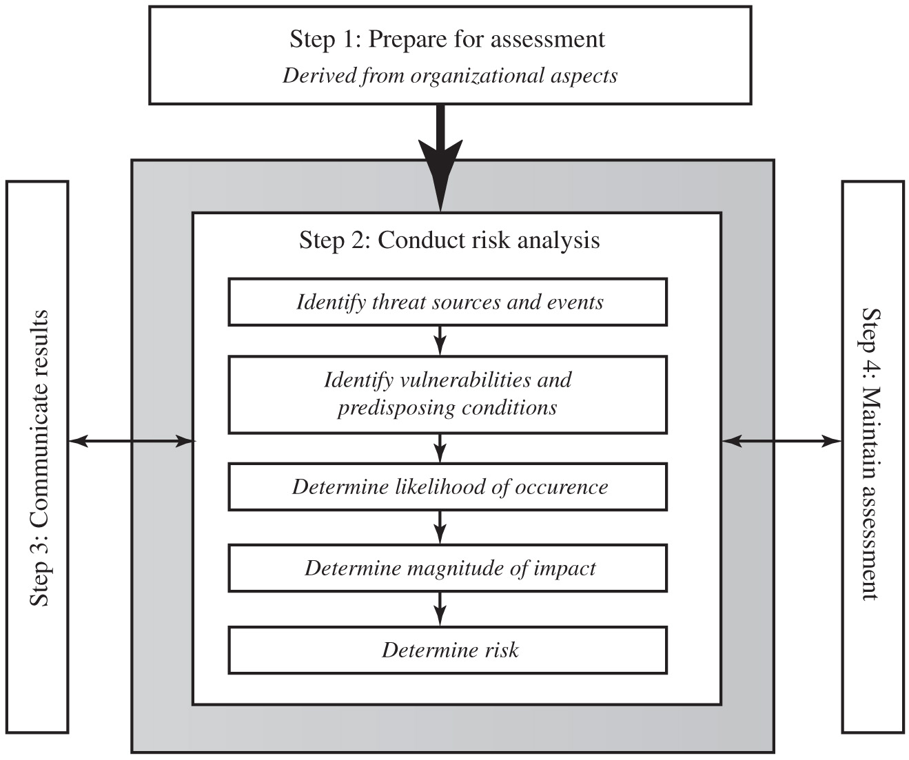
Figure 14.3 Risk Assessment Process
Notes:
A number of national and international standards document the expected formal risk analysis approach. These include ISO 27005, ISO 31000, NIST SP 800-30, and [SASN13]. This approach is often mandated by government organizations and associated businesses. These standards all broadly agree on the process used. Figure 14.3 (reproduced from figure 5 in NIST SP 800-30) illustrates a typical process used.
The steps are as follows. Step 1. Prepare for assessment, derived from organizational aspects. Step 2. Conduct risk analysis. Identify threat sources and events. Identify vulnerabilities and predisposing conditions. Determine likelihood of occurrence. Determine magnitude of impact. Determine risk. Step 3. Communicate results. Step 4. Maintain assessment.

Slide 9
Establishing the Context
Initial step
Determine the basic parameters of the risk assessment
Identify the assets to be examined
Explores political and social environment in which the organization operates
Legal and regulatory constraints
Provide baseline for organization’s risk exposure
Risk appetite
The level of risk the organization views as acceptable
Notes:
The initial step is known as establishing the context or system characterization . Its purpose is to determine the basic parameters within which the risk assessment will be conducted, and then to identify the assets to be examined.
The process starts with the organizational security objectives and considers the broad risk exposure of the organization. This recognizes that not all organizations are equally at risk, but that some, because of their function, may be specifically targeted. It explores the relationship between a specific organization and the wider political and social environment in which it operates.
Industries such as agriculture and education are considered to be at lesser risk compared to government or banking and finance. Note that this classification predates September 11, and it is likely that there has been change since it was developed. In particular it is likely that utilities, for example, are probably at higher risk than the classification suggests. NIST has indicated that the following industries are vulnerable to risks in Supervisory Control and Data
Acquisition (SCADA) and process control systems: electric, water and wastewater, oil and natural gas, chemical, pharmaceutical, pulp and paper, food and beverage, discrete manufacturing (automotive, aerospace, and durable goods), air and rail transportation, and mining and metallurgy.
At this point in determining an organization’s broad risk exposure, any relevant legal and regulatory constraints must also be identified. These features provide a baseline for the organization’s risk exposure and an initial indication of the broad scale of resources it needs to expend to manage this risk in order to successfully conduct business.
Next, senior management must define the organization’s risk appetite , the level of risk the organization views as acceptable. Again this will depend very much on the type of organization, and its management’s attitude to how it conducts business. For example, banking and finance organizations tend to be fairly conservative and risk averse. This means they want a low residual risk and are willing to spend the resources necessary to achieve this. In contrast, a leading-edge manufacturer with a brand new product may have a much greater risk tolerance. The manufacturer is willing to take a chance to obtain a competitive advantage, and with limited resources wishes to expend less on risk controls. This decision is not just IT specific. Rather it reflects the organization’s broader management approach to how it conducts business.

Slide 10
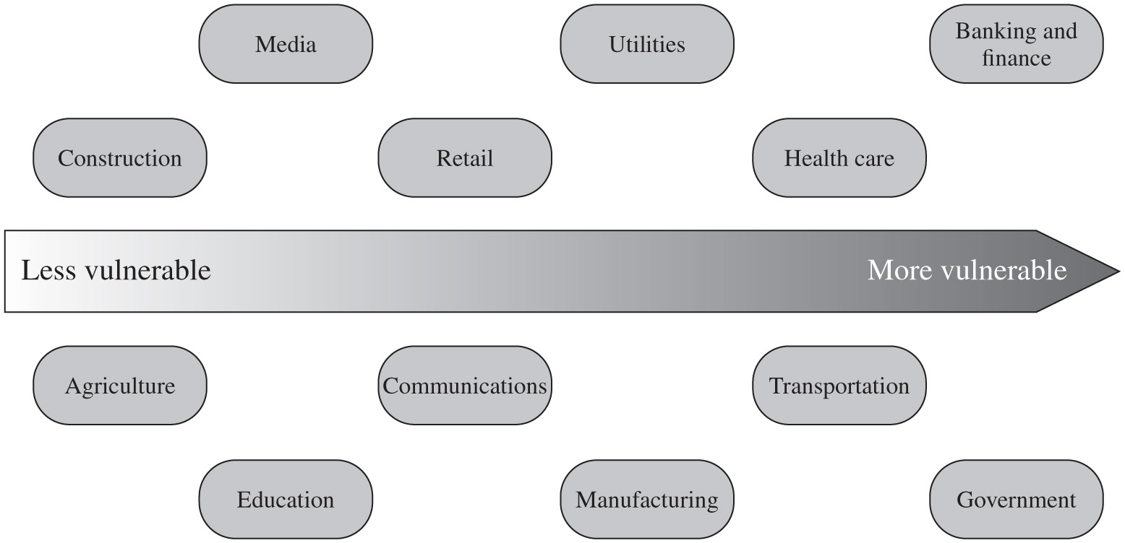
Figure 14.4 Generic Organizational Risk Context
Notes:
Figure 14.4 (adapted from an IDC 2000 report) suggests a possible spectrum of organizational risk. The organizational risk ranges from less vulnerable to more vulnerable. The contexts are as follows. Construction, Media, Retail, Utilities, Health care, Banking and finance, Agriculture, Education, Communication, Manufacturing, Transportation, and Government.

Slide 11
Asset Identification
Last component is to identify assets to examine
Draw on expertise of people in relevant areas of organization to identify key assets
Identify and interview such personnel
Asset
“anything that needs to be protected” because it has value to the organization and contributes to the successful attainment of the organization’s objectives
Notes:
The last component of this first step in the risk assessment is to identify the assets to examine. This directly addresses the first of the three fundamental questions we opened this chapter with: “What assets do we need to protect?” An asset is “anything that needs to be protected” because it has value to the organization and contributes to the successful attainment of the organization’s objectives. As we discuss in Chapter 1, an asset may be either tangible or intangible. It includes computer and communications hardware infrastructure, software (including applications and information/data held on these systems), the documentation on these systems, and the people who manage and maintain these systems. Within the boundaries identified for the risk assessment, these assets need to be identified and their value to the organization assessed. It is important to emphasize again that while the ideal is to consider every conceivable asset, in practice this is not possible. Rather the goal here is to identify all assets that contribute significantly to attaining the organization’s objectives and whose compromise or loss would seriously impact on the organization’s operation. [SASN13] describes this process as a criticality assessment that aims to identify those assets that are most important to the organization.
While the risk assessment process is most likely being managed by security experts, they will not necessarily have a high degree of familiarity with the organization’s operation and structures. Thus they need to draw on the expertise of the people in the relevant areas of the organization to identify key assets and their value to the organization. A key element of this process step is identifying and interviewing such personnel. Many of the standards listed previously include checklists of types of assets and suggestions for mechanisms for gathering the necessary information. These should be consulted and used. The outcome of this step should be a list of assets, with brief descriptions of their use by, and value to, the organization.

Slide 12
Terminology
Asset:
A system resource or capability of value to its owner that requires protection.
Threat:
A potential for a threat source to exploit a vulnerability in some asset, which if it occurs may compromise the security of the asset and cause harm to the asset’s owner.
Vulnerability:
A flaw or weakness in an asset’s design, implementation, or operation and management that could be exploited by some threat.
Risk:
The potential for loss computed as the combination of the likelihood that a given threat exploits some vulnerability to an asset, and the magnitude of harmful consequence that results to the asset’s owner.
Notes:
The next step in the process is to identify the threats or risks the assets are exposed to. This directly addresses the second of our three fundamental questions: “How are those assets threatened?” It is worth commenting on the terminology used here. The terms threat and risk, while having distinct meanings, are often used interchangeably in this context. There is considerable variation in the definitions of these terms, as seen in the range of definitions provided in the cited standards. The following definitions will be useful in our discussion:
The relationship among these and other security concepts is illustrated in Figure 1.2.
The goal of this stage is to identify potentially significant risks to the assets listed. This requires answering the following questions for each asset:
1. Who or what could cause it harm?
2. How could this occur?

Slide 13
Threat Identification
A threat is:
Anything that might hinder or prevent an asset from providing appropriate levels of the key security services
Integrity
Availability
Accountability
Authenticity
Reliability
Confidentiality
Notes:
Answering the first of these questions involves identifying potential threats to assets. In the broadest sense, a threat is anything that might hinder or prevent an asset from providing appropriate levels of the key security services: confidentiality, integrity, availability, accountability, authenticity, and reliability. Note that one asset may have multiple threats, and a single threat may target multiple assets.

Slide 14
Threat Sources
Threats may be
Natural “acts of God”
Man-made
Accidental or deliberate
Evaluation of human threat sources should consider:
Motivation
Capability
Resources
Probability of attack
Deterrence
Any previous experience of attacks seen by the organization also needs to be considered
Notes:
A threat may be either natural or human-made and may be accidental or deliberate. This is known as the threat source or threat agent. The classic natural threat sources are those often referred to as acts of God, and include damage caused by fire, flood, storm, earthquake, and other such natural events. It also includes environmental threats such as long-term loss of power or natural gas. Or it may be the result of chemical contamination or leakage. Alternatively, a threat source may be a human agent acting either directly or indirectly. Examples of the former include an insider retrieving and selling information for personal gain or a hacker targeting the organization’s server over the Internet. An example of the latter includes someone writing and releasing a network worm that infects the organization’s systems. These examples all involved a deliberate exploit of a threat. However, a threat may also be a result of an accident, such as an employee incorrectly entering information on a system, which results in the system malfunctioning.
Identifying possible threats and threat sources requires the use of a variety of sources, along with the experience of the risk assessor. The chance of natural threats occurring in any particular area is usually well known from insurance statistics. Lists of other potential threats may be found in the standards, in the results of IT security surveys, and in information from government security agencies. The annual computer crime reports, such as those by CSI/FBI and by Verizon in the United States, and similar reports in other countries, provide useful general guidance on the broad IT threat environment and the most common problem areas. Standards, such as NIST SP 800-30 Appendix D with a taxonomy of threat sources, and Appendix E with examples of threats, may also assist here.
However, this general guidance needs to be tailored to the organization and the risk environment it operates in. This involves consideration of vulnerabilities in the organization’s IT systems, which may indicate that some risks are either more or less likely than the general case. Where an organization’s security concerns are sufficiently high that threats need to be specifically identified, threat scenarios can be modelled, developed, and analyzed, as described in NIST SP 800-30. Organization’s define threat scenarios to describe how the tactics, techniques, and procedures employed by an attacker can contribute to, or cause, harm. The possible motivation of deliberate attackers in relation to the organization should be considered as potentially influencing this variation in risk. In addition, any previous experience of attacks seen by the organization needs to be considered, as that is concrete evidence of risks that are known to occur. When evaluating possible human threat sources, it is worth considering their reason and capabilities for attacking this organization, including their:
• Motivation: Why would they target this organization; how motivated are they?
• Capability: What is their level of skill in exploiting the threat?
• Resources: How much time, money, and other resources could they deploy?
• Probability of attack: How likely and how often would your assets be targeted?
• Deterrence: What are the consequences to the attacker of being identified?

Slide 15
Vulnerability Identification
Identify exploitable flaws or weaknesses in organization’s I T systems or processes
Determines applicability and significance of threat to organization
Need combination of threat and vulnerability to create a risk to an asset
Outcome should be a list of threats and vulnerabilities with brief descriptions of how and why they might occur
Notes:
Answering the second of these questions, “How could this occur?” involves identifying flaws or weaknesses in the organization’s IT systems or processes that could be exploited by a threat. This will help determine the applicability of the threat to the organization and its significance. Note that the mere existence of some vulnerability does not mean harm will be caused to an asset. There must also be a threat source for some threat that can exploit the vulnerability for harm. It is the combination of a threat and a vulnerability that creates a risk to an asset.
Again, many of the standards listed previously include checklists of threats and vulnerabilities and suggestions for tools and techniques to list them and to determine their relevance to the organization. The outcome of this step should be a list of threats and vulnerabilities, with brief descriptions of how and why they might occur.

Slide 16
Analyze Risks
Specify likelihood of occurrence of each identified threat to asset given existing controls
Specify consequence should threat occur
Derive overall risk rating for each threat
Hard to determine accurate probabilities and realistic cost consequences
Use qualitative, not quantitative, ratings
Notes:
Having identified key assets and the likely threats and vulnerabilities they are exposed to, the next step is to determine the level of risk each of these poses to the organization. The aim is to identify and categorize the risks to assets that threaten the regular operations of the organization. Risk analysis also provides information to management to help managers evaluate these risks and determine how best to treat them. Risk analysis involves first specifying the likelihood of occurrence of each identified threat to an asset, in the context of any existing controls. Next, the consequence to the organization is determined, should that threat eventuate. Lastly, this information is combined to derive an overall risk rating for each threat. The ideal would be to specify the likelihood as a probability value and the consequence as a monetary cost to the organization should it occur. The resulting risk is then simply given as
Risk = (Probability that threat occurs) x (Cost to organization)
This can be directly equated to the value the threatened asset has for the organization, and hence specify what level of expenditure is reasonable to reduce the probability of its occurrence to an acceptable level. Unfortunately, it is often extremely hard to determine accurate probabilities, realistic cost consequences, or both. This is particularly true of intangible assets, such as the loss of confidentiality of a trade secret. Hence, most risk analyses use qualitative, rather than quantitative, ratings for both these items. The goal is then to order the resulting risks to help determine which need to be most urgently treated, rather than to give them an absolute value.

Slide 17
Analyze Existing Controls
Existing controls used to attempt to minimize threats need to be identified
Security controls include:
Management
Operational
Technical processes and procedures
Use checklists of existing controls and interview key organizational staff to solicit information
Notes:
Before the likelihood of a threat can be specified, any existing controls used by the organization to attempt to minimize threats need to be identified. Security controls include management, operational, and technical processes and procedures that act to reduce the exposure of the organization to some risks by reducing the ability of a threat source to exploit some vulnerabilities. These can be identified by using checklists of existing controls, and by interviewing key organizational staff to solicit this information.

Slide 18
Table 14.2 Risk Likelihood
Rating | Likelihood Description | Expanded Definition
1 | Rare | May occur only in exceptional circumstances and may be deemed as “unlucky” or very unlikely.
2 | Unlikely | Could occur at some time but not expected given current controls, circumstances, and recent events.
3 | Possible | Might occur at some time, but just as likely as not. It may be difficult to control its occurrence due to external influences.
4 | Likely | Will probably occur in some circumstance and one should not be surprised if it occurred.
5 | Almost Certain | Is expected to occur in most circumstances and certainly sooner or later.
Notes:
Having identified existing controls, the likelihood that each identified threat could occur and cause harm to some asset needs to be specified. The likelihood is typically described qualitatively, using values and descriptions such as those shown in Table 14.2. While the various risk assessment standards all suggest tables similar to these, there is considerable variation in their detail. The selection of the specific descriptions and tables used is determined at the beginning of the risk assessment process, when the context is established.
There will very likely be some uncertainty and debate over exactly which rating is most appropriate. This reflects the qualitative nature of the ratings, ambiguity in their precise meaning, and uncertainty over precisely how likely it is that some threat may eventuate. It is important to remember that the goal of this process is to provide guidance to management as to which risks exist, and provide enough information to help management decide how to most appropriately respond. Any uncertainty in the selection of ratings should be noted in the discussion on their selection, but ultimately management will make a business decision in response to this information.
The risk analyst takes the descriptive asset and threat/vulnerability details from the preceding steps in this process and, in light of the organization’s overall risk environment and existing controls, decides the appropriate rating. This estimation relates to the likelihood of the specified threat exploiting one or more vulnerabilities to an asset or group of assets, which results in harm to the organization. The specified likelihood needs to be realistic. In particular, a rating of likely or higher suggests that this threat has occurred sometime previously. This means past history provides supporting evidence for its specification. If this is not the case, then specifying such a value would need to be justified on the basis of a significantly changed threat environment, a change in the IT system that has weakened its security, or some other rationale for the threat’s anticipated likely occurrence. In contrast, the Unlikely and Rare ratings can be very hard to quantify. They are an indication that the threat is of concern, but whether it could occur is difficult to specify. Typically such threats would only be considered if the consequences to the organization of their occurrence are so severe that they must be considered, even if extremely improbable.

Slide 19
Table 14.3 Risk Consequences (1 of 2)
Rating | Consequence | Expanded Definition
1 | Insignificant | Generally, a result of a minor security breach in a single area. Impact is likely to last less than several days and requires only minor expenditure to rectify. Usually does not result in any tangible detriment to the organization.
2 | Minor | Result of a security breach in one or two areas. Impact is likely to last less than a week but can be dealt with at the segment or project level without management intervention. Can generally be rectified within project or team resources. Again, does not result in any tangible detriment to the organization, but may, in hindsight, show previous lost opportunities or lack of efficiency.
3 | Moderate | Limited systemic (and possibly ongoing) security breaches. Impact is likely to last up to 2 weeks and will generally require management intervention, though should still be able to be dealt with at the project or team level. Will require some ongoing compliance costs to overcome. Customers or the public may be indirectly aware or have limited information about this event.
4 | Major | Ongoing systemic security breach. Impact will likely last 4–8 weeks and require significant management intervention and resources to overcome. Senior management will be required to sustain ongoing direct management for the duration of the incident and compliance costs are expected to be substantial. Customers or the public will be aware of the occurrence of such an event and will be in possession of a range of important facts. Loss of business or organizational outcomes is possible, but not expected, especially if this is a once-off.
Notes:
The analyst must then specify the consequence of a specific threat eventuating. Note this is distinct from, and not related to, the likelihood of the threat occurring. Rather, consequence specification indicates the impact on the organization should the particular threat in question actually eventuate. Even if a threat is regarded as rare or unlikely, if the organization would suffer severe consequence should it occur, then it clearly poses a risk to the organization. Hence, appropriate responses must be considered. A qualitative descriptive value, such as those shown in Table 14.3, is typically used to describe the consequence. As with the likelihood ratings, there is likely to be some uncertainty as to the best rating to use.
This determination should be based upon the judgment of the asset’s owners, and the organization’s management, rather than the opinion of the risk analyst. This is in contrast with the likelihood determination. The specified consequence needs to be realistic. It must relate to the impact on the organization as a whole should this specific threat eventuate. It is not just the impact on the affected system. It is possible that a particular system (a server in one location, for example) might be completely destroyed in a fire. However, the impact on the organization could vary from it being a minor inconvenience (the server was in a branch office, and all data were replicated elsewhere) to a major disaster (the server had the sole copy of all customer and financial records for a small business). As with the likelihood ratings, the consequence ratings must be determined knowing the organization’s current practices and arrangements. In particular, the organization’s existing backup, disaster recovery, and contingency planning, or lack thereof, will influence the choice of rating.

Slide 20
Table 14.3 Risk Consequences (2 of 2)
Table 14.3 [Continued]
Rating | Consequence | Expanded Definition
5 | Catastrophic | Major systemic security breach. Impact will last for 3 months or more and senior management will be required to intervene for the duration of the event to overcome shortcomings. Compliance costs are expected to be very substantial. A loss of customer business or other significant harm to the organization is expected. Substantial public or political debate about, and loss of confidence in, the organization is likely. Possible criminal or disciplinary action against personnel involved is likely.
6 | Doomsday | Multiple instances of major systemic security breaches. Impact duration cannot be determined and senior management will be required to place the company under voluntary administration or other form of major restructuring. Criminal proceedings against senior management is expected, and substantial loss of business and failure to meet organizational objectives is unavoidable. Compliance costs are likely to result in annual losses for some years, with liquidation of the organization likely.

Slide 21
Table 14.4 Risk Level Determination and Meaning
Consequences
Likelihood | Doomsday | Catastrophic | Major | Moderate | Minor | Insignificant
Almost Certain | E | E | E | E | H | H
Likely | E | E | E | H | H | M
Possible | E | E | E | H | M | L
Unlikely | E | E | H | M | L | L
Rare | E | H | H | M | L | L
Risk Level | Description
Extreme (E) | Will require detailed research and management planning at an executive/director level. Ongoing planning and monitoring will be required with regular reviews. Substantial adjustment of controls to manage the risk is expected, with costs possibly exceeding original forecasts.
High (H) | Requires management attention, but management and planning can be left to senior project or team leaders. Ongoing planning and monitoring with regular reviews are likely, though adjustment of controls is likely to be met from within existing resources.
Medium (M) | Can be managed by existing specific monitoring and response procedures. Management by employees is suitable with appropriate monitoring and reviews.
Low (L) | Can be managed through routine procedures.
Notes:
Once the likelihood and consequence of each specific threat have been identified, a final level of risk can be assigned. This is typically determined using a table that maps these values to a risk level, such as those shown in Table 14.4. This table details the risk level assigned to each combination. Such a table provides the qualitative equivalent of performing the ideal risk calculation using quantitative values. It also indicates the interpretation of these assigned levels.

Slide 22
Table 14.5 Risk Register
Asset | Threat/Vulnerability | Existing Controls | Likelihood | Consequence | Level of Risk | Risk Priority
Internet router | Outside hacker attack | Admin password only | Possible | Moderate | High | 1
Destruction of data Center | Accidental fire or flood | None (no disaster recovery plan) | Unlikely | Major | High | 2
Notes:
The results of the risk analysis process should be documented in a risk register. This should include a summary table such that shown in Table 14.5 . The risks are usually sorted in decreasing order of level. This would be supported by details of how the various items were determined, including the rationale, justification, and supporting evidence used. The aim of this documentation is to provide senior management with the information needed to make appropriate decisions as how to best manage the identified risks. It also provides evidence that a formal risk assessment process has been followed if needed, and a record of decisions made with the reasons for those decisions.
Once the details of potentially significant risks are determined, management needs to decide whether it needs to take action in response. This would take into account the risk profile of the organization and its willingness to accept a certain level of risk, as determined in the initial establishing the context phase of this process. Those items with risk levels below the acceptable level would usually be accepted with no further action required. Those items with risks above this will need to be considered for treatment.

Slide 23
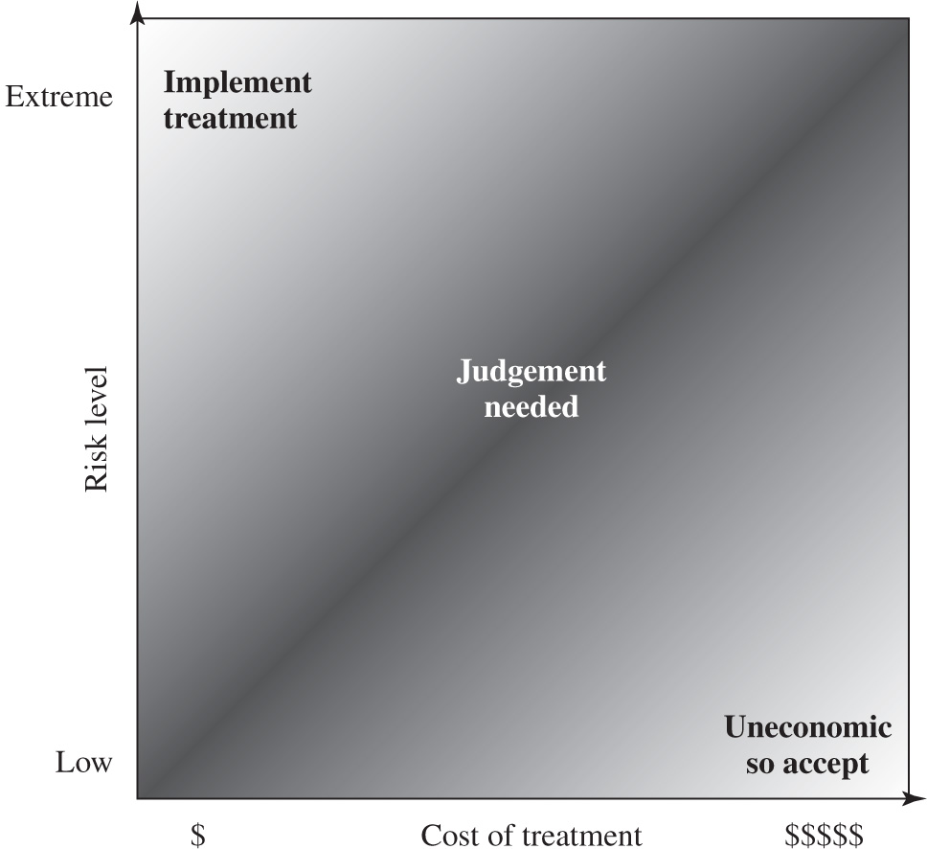
Figure 14.5 Judgment About Risk Treatment
Notes:
Typically the risks with the higher ratings are those that need action most urgently. However, it is likely that some risks will be easier, faster, and cheaper to address than others. In the example risk register shown in Table 14.5, both risks were rated High. Further investigation reveals that a relatively simple and cheap treatment exists for the first risk by tightening the router configuration to further restrict possible accesses. Treating the second risk requires developing a full disaster recovery plan, a much slower and more costly process. Hence management would take the simple action first to improve the organization’s overall risk profile as quickly as possible. Management may even decide that for business reasons, given an overall view of the organization, some risks with lower levels should be treated ahead of other risks. This is a reflection of both limitations in the risk analysis process in the range of ratings available and their interpretation, and of management’s perspective of the organization as a whole.
Figure 14.5 indicates a range of possibilities for costs versus levels of risk. If the cost of treatment is high, but the risk is low, then it is usually uneconomic to proceed with such treatment. Alternatively, where the risk is high and the cost comparatively low, treatment should occur. The most difficult area occurs between these extremes. This is where management must make a business decision about the most effective use of their available resources. This decision usually requires a more detailed investigation of the treatment options.
If the cost of treatment is extreme, but the risk is low, then it is usually uneconomic, so accept. Alternatively, where the risk is extreme and the cost comparatively low, treatment should be implemented.

Slide 24
Risk Treatment Alternatives
Risk acceptance
Choosing to accept a risk level greater than normal for business reasons
Risk avoidance
Not proceeding with the activity or system that creates this risk
Risk transfer
Sharing responsibility for the risk with a third party
Reduce consequence
Modifying the structure or use of the assets at risk to reduce the impact on the organization should the risk occur
Reduce likelihood
Implement suitable controls to lower the chance of the vulnerability being exploited
Notes:
There are five broad alternatives available to management for treating identified risks:
Risk acceptance: Choosing to accept a risk level greater than normal for business reasons. This is typically due to excessive cost or time needed to treat the risk. Management must then accept responsibility for the consequences to the organization should the risk eventuate.
• Risk avoidance: Not proceeding with the activity or system that creates this risk. This usually results in loss of convenience or ability to perform some function that is useful to the organization. The loss of this capability is traded off against the reduced risk profile.
• Risk transfer: Sharing responsibility for the risk with a third party. This is typically achieved by taking out insurance against the risk occurring, by entering into a contract with another organization, or by using partnership or joint venture structures to share the risks and costs should the threat eventuate.
• Reduce consequence: By modifying the structure or use of the assets at risk to reduce the impact on the organization should the risk occur. This could be achieved by implementing controls to enable the organization to quickly recover should the risk occur. Examples include implementing an off-site backup process, developing a disaster recovery plan, or arranging for data and processing to be replicated over multiple sites.
• Reduce likelihood: By implementing suitable controls to lower the chance of the vulnerability being exploited. These could include technical or administrative controls such as deploying firewalls and access tokens, or procedures such as password complexity and change policies. Such controls aim to improve the security of the asset, making it more difficult for an attack to succeed by reducing the vulnerability of the asset.
If either of the last two options is chosen, then possible treatment controls need to be selected and their cost effectiveness evaluated. There is a wide range of available management, operational, and technical controls that may be used. These would be surveyed to select those that might address the identified threat most effectively and to evaluate the cost to implement against the benefit gained. Management would then choose among the options as to which should be adopted and plan for their implementation. We introduce the range of controls often used and the use of security plans and policies in Chapter 15 and provide further details of some specific control areas in Chapters 16 – 18 .

Slide 25
Case Study: Silver Star Mines
Fictional operation of global mining company
Large I T infrastructure
Both common and specific software
Some directly relates to health and safety
Formerly isolated systems now networked
Decided on combined approach
Mining industry less risky end of spectrum
Subject to legal/regulatory requirements
Management accepts moderate or low risk
Notes:
A case study involving the operations of a fictional company Silver Star Mines illustrates this risk assessment process. Silver Star Mines is the local operations of a large global mining company. It has a large IT infrastructure used by numerous business areas. Its network includes a variety of servers, executing a range of application software typical of organizations of its size. It also uses applications that are far less common, some of which directly relate to the health and safety of those working in the mine. Many of these systems used to be isolated, with no network connections among them. In recent years, they have been connected together and connected to the company’s intranet to provide better management capabilities. However, this means they are now potentially accessible from the Internet, which has greatly increased the risks to these systems.
A security analyst was contracted to provide an initial review of the company’s risk profile and to recommend further action for improvement. Following initial discussion with company management, a decision was made to adopt a combined approach to security management. This requires the adoption of suitable baselines standards by the company’s IT support group for their systems. Meanwhile, the analyst was asked to conduct a preliminary formal assessment of the key IT systems to identify those most at risk, which management could then consider for treatment.
The first step was to determine the context for the risk assessment. Being in the mining industry sector places the company at the less risky end of the spectrum, and consequently less likely to be specifically targeted. Silver Star Mines is part of a large organization and hence is subject to legal requirements for occupational health and safety and is answerable to its shareholders. Thus management decided that it wished to accept only moderate or lower risks in general. The boundaries for this risk assessment were specified to include only the systems under the direct control of the Silver Star Mines operations. This excluded the wider company intranet, its central servers, and its Internet gateway. This assessment is sponsored by Silver Star’s IT and engineering managers, with results to be reported to the company board. The assessment would use the process and ratings described in this chapter.

Slide 26

Assets
Reliability and integrity of S C A D A nodes and net
Availability, integrity and confidentiality of mail services
Integrity of stored file and database information
Availability, integrity of maintenance/production system
Availability, integrity of financial system
Availability, integrity of procurement system
Notes:
Next, the key assets had to be identified. The analyst conducted interviews with key IT and engineering managers in the company. A number of the engineering managers emphasized how important the reliability of the SCADA network and nodes were to the company. They control and monitor the core mining operations of the company and enable it to operate safely and efficiently and, most crucially, to generate revenue. Some of these systems also maintain the records required by law, which are regularly inspected by the government agencies responsible for the mining industry. Any failure to create, preserve, and produce on demand these records would expose the company to fines and other legal sanctions. Hence, these systems were listed as the first key asset.
A number of the IT managers indicated that a large amount of critical data was stored on various file servers either in individual files or in databases. They identified the importance of the integrity of these data to the company. Some of these data were generated automatically by applications. Other data were created by employees using common office applications. Some of this needed be available for audits by government agencies. There were also data on production and operational results, contracts and tendering, personnel, application backups, operational and capital expenditure, mine survey and planning, and exploratory drilling. Collectively, the integrity of stored data was identified as the second key asset.
These managers also indicated that three key systems—the Financial, Procurement, and Maintenance/Production servers—were critical to the effective operation of core business areas. Any compromise in the availability or integrity of these systems would impact the company’s ability to operate effectively. Hence each of these were identified as a key asset.

Slide 27
Table 14.6 Silver Star Mines Risk Register
Asset | Threat/Vulnerability | Existing Controls | Likelihood | Consequence | Level of Risk | Risk Priority
Reliability and integrity of the SCADA nodes and network | Unauthorized modification of control system | Layered firewalls and servers | Rare | Major | High | 1
Integrity of stored file and database Information | Corruption, theft, and loss of info | Firewall, policies | Possible | Major | Extreme | 2
Availability and integrity of financial system | Attacks/errors affecting system | Firewall, policies | Possible | Moderate | High | 3
Availability and integrity of Procurement system | Attacks/errors affecting system | Firewall, policies | Possible | Moderate | High | 4
Availability and integrity of maintenance/production system | Attacks/errors affecting system | Firewall, policies | Possible | Minor | Medium | 5
Availability, integrity, and confidentiality of mail services | Attacks/errors affecting system | Firewall, ext mail gateway | Almost Certain | Minor | High | 6
Notes:
Lastly, the analyst identified e-mail as a key asset, as a result of interviews with all business areas of the company. The use of e-mail as a business tool cuts across all business areas. Around 60% of all correspondence is in the form of e-mail, which is used to communicate daily with head office, other business units, suppliers, and contractors, as well as to conduct a large amount of internal correspondence. E-mail is given greater importance than usual due to the remote location of the company. Hence the collective availability, integrity, and confidentiality of mail services was listed as a key asset.
This list of key assets is seen in the first column of Table 14.6, which is the risk register created at the conclusion of this risk assessment process.
Having determined the list of key assets, the analyst needed to identify significant threats to these assets and to specify the likelihood and consequence values. The major concern with the SCADA asset is unauthorized compromise of nodes by an external source. These systems were originally designed for use on physically isolated and trusted networks and hence were not hardened against external attack to the degree that modern systems can be. Often these systems are running older releases of operating systems with known insecurities. Many of these systems have not been patched or upgraded because the key applications they run have not been updated or validated to run on newer OS versions. More recently, the SCADA networks have been connected to the company’s intranet to provide improved management and monitoring capabilities. Recognizing that the SCADA nodes are very likely insecure, these connections are isolated from the company intranet by additional firewall and proxy server systems. Any external attack would have to break through the outer company firewall, the SCADA network firewall, and these proxy servers in order to attack the SCADA nodes. This would require a series of security breaches. Nonetheless, given that the various computer crime surveys suggest that externally sourced attacks are increasing and known cases of attacks on SCADA networks exist, the analyst concluded that while an attack was very unlikely, it could still occur. Thus a likelihood rating of Rare was chosen. The consequence of the SCADA network suffering a successful attack was discussed with the mining engineers. They indicated that interference with the control system could have serious consequences as it could affect the safety of personnel in the mine. Ventilation, bulk cooling, fire protection, hoisting of personnel and materials, and underground fill systems are possible areas whose compromise could lead to a fatality. Environmental damage could result from the spillage of highly toxic materials into nearby waterways. Additionally, the financial impact could be significant, as downtime is measured in tens of millions of dollars per hour. There is even a possibility that Silver Star’s mining license might be suspended if the company was found to have breached its legal requirements. A consequence rating of Major was selected. This results in a risk level of High.
The second asset concerned the integrity of stored information. The analyst noted numerous reports of unauthorized use of file systems and databases in recent computer crime surveys. These assets could be compromised by both internal and external sources. These can be either the result of intentional malicious or fraudulent acts, or the unintentional deletion, modification, or disclosure of information. All indications are that such database security breaches are increasing and that access to such data is a primary goal of intruders. These systems are located on the company intranet and hence are shielded by the company’s outer firewall from much external access. However, should that firewall be compromised or an attacker gain indirect access using infected internal systems, compromise of the data was possible. With respect to internal use, the company had policies on the input and handling of a range of data, especially that required for audit purposes. The company also had policies on the backup of data from servers. However, the large number of systems used to create and store this data, both desktop and server, meant that overall compliance with these policies was unknown. Hence a likelihood rating of Possible was chosen. Discussions with some of the company’s IT managers revealed that some of this information is confidential and may cause financial harm if disclosed to others. There also may be substantial financial costs involved with recovering data and other activities subsequent to a breach. There is also the possibility of serious legal consequences if personal information was disclosed or if the results of statutory tests and process information were lost. Hence a consequence rating of Major was selected. This results in a risk level of Extreme.
The availability or integrity of the key Financial, Procurement, and Maintenance/Production systems could be compromised by any form of attack on the operating system or applications they use. Although their location on the company intranet does provide some protection, due to the nature of the company structure a number of these systems have not been patched or maintained for some time. This means at least some of the systems would be vulnerable to a range of network attacks if accessible. Any failure of the company’s outer firewall to block any such attack could very likely result in compromise of some systems by automated attack scans. These are known to occur very quickly, with a number of reports indicating that unpatched systems were compromised in less than 15 minutes after network connection. Hence a likelihood of Possible was specified. Discussions with management indicated that the degree of harm would be proportional to extent and duration of the attack. In most cases a rebuild of at least a portion of the system would be required, at considerable expense. False orders being issued to suppliers or the inability to issue orders would have a negative impact on the company’s reputation and could cause confusion and possible plant shutdowns. Not being able to process personnel time sheets and utilize electronic funds transfer and unauthorized transfer of money would also affect the company’s reputation and possibly result in a financial loss. The company indicated that the Maintenance/Production system’s harm rating should be a little lower due the ability of the plant to continue to operate despite some compromise of the system. It would, however, have a detrimental impact on the efficiency of operations. Consequence ratings of Moderate and Minor, respectively, were selected, resulting in risk levels of High or Medium.
The last asset is the availability, integrity, and confidentiality of mail services. Without an effective e-mail system, the company will operate with less efficiency. A number of organizations have suffered failure of their e-mail systems as a result of mass e-mailed worms in past years. New exploits transferred using e-mail are reported. Those exploiting vulnerabilities in common applications are of major concern. The heavy use of e-mail by the company, including the constant exchange and opening of e-mail attachments by employees, means the chance of compromise, especially by a zero-day exploit to a common document type, is very high. While the company does filter mail in its Internet gateway, there is a high probability that a zero-day exploit would not be caught. A denial of service attack against the mail gateway is very hard to defend against. Hence a likelihood rating of Almost Certain was selected in recognition of the wide range of possible attacks and the high chance that one will occur sooner rather than later. Discussions with management indicated that while other possible modes of communication exist, they do not allow for transmission of electronic documents. The ability to obtain electronic quotes is a requirement that must be met to place an order in the purchasing system. Reports and other communications are regularly sent via this e-mail, and any inability to send or receive such reports might affect the company’s reputation. There would also be financial costs and time needed to rebuild the e-mail system following a serious compromise. Because compromise would not have a large impact, a consequence rating of Minor was selected. This results in a risk level of High.
The information was summarized and presented to management. All of the resulting risk levels are above the acceptable minimum management specified as tolerable. Hence treatment is required. Even though the second asset listed had the highest level of risk, management decided that the risk to the SCADA network was unacceptable if there was any possibility of death, however remote. Additionally, the management decided that the government regulator would not look favorably upon a company that failed to rate highly the importance of a potential fatality. Consequently, the management decided to specify the risk to the SCADA as the highest priority for treatment. The risk to the integrity of stored information was next. The management also decided to place the risk to the e-mail systems last, behind the lower risk to the Maintenance/Production system, in part because its compromise would not affect the output of the mining and processing units and also because treatment would involve the company’s mail gateway, which was outside the management’s control.
The final result of this risk assessment process is shown in Table 14.6, the resulting overall risk register table. It shows the identified assets with the threats to them, and the assigned ratings and priority. This information would then influence the selection of suitable treatments. Management decided the first five risks should be treated by implementing suitable controls, which would reduce either the likelihood or the consequence should these risks occur. This process is discussed in the next chapter. None of these risks could be accepted or avoided. Responsibility for the final risk to the e-mail system was found to be primarily with the parent company’s IT group, which manages the external mail gateway. Hence the risk is shared with that group.

Slide 28

Copyright
This work is protected by United States copyright laws and is provided solely for the use of instructors in teaching their courses and assessing student learning. Dissemination or sale of any part of this work (including on the World Wide Web) will destroy the integrity of the work and is not permitted. The work and materials from it should never be made available to students except by instructors using the accompanying text in their classes. All recipients of this work are expected to abide by these restrictions and to honor the intended pedagogical purposes and the needs of other instructors who rely on these materials.

